Slide 1
软件工程
张爽
东北大学软件学院

Slide 2
1.1
Software Concept

Slide 3
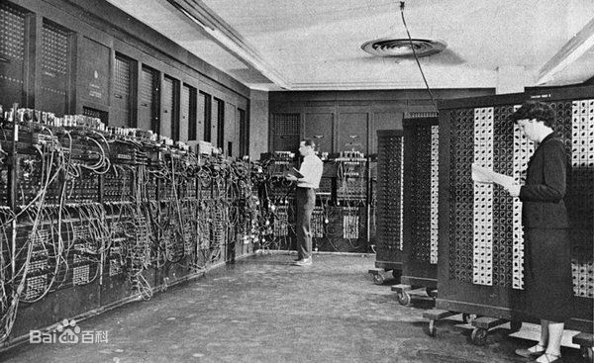
Software History
The 1st-generation computer, 1945~1957, Vacuum Tubes
The first computer in 1946

Slide 4
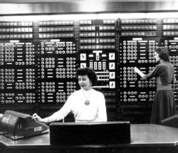
Software History
The 2nd-generation computer, 1958~1964, Transistor

Slide 5
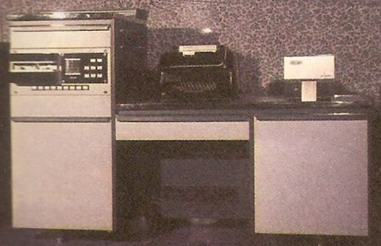
Software History
The 3rd-generation computer, 1965~1970, Integrated Circuit

Slide 6
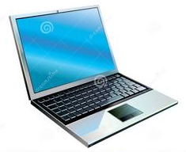
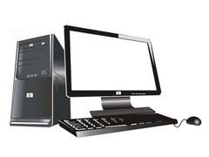
Software History
The 4th-generation computer, 1971~present, Large-scale Integrated Circuit----Personal Computer

Slide 7
Software History
What software have you used ?

Slide 8
Software Concept
code in machine-readable form
data (temporary and permanent data)
All the documents
  Specification documents
  Design documents
  Legal and accounting documents
  Software project management plan
  All types of manuals
  Other management documents

Slide 9
Software Characteristics
Software is abstract. It is a kind of logic entity, not concrete physical entity.
Software does NOT wear out.
Software is portable.
Software is complex.
Software is expensive.

Slide 10
DISCUSS
Please tell a case or one of your stories which proves that you have benefited or suffered from a characteristic of software.

